Slide 1
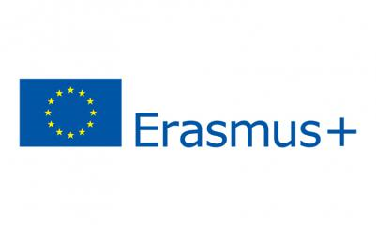
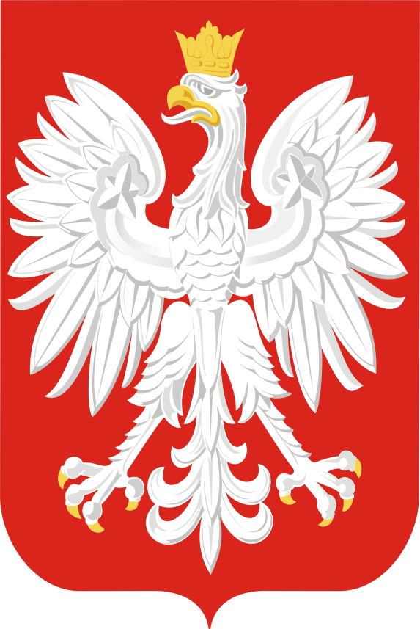
POLAND
TRAVEL MANUAL
CAPITAL AND LARGEST CITY: Warsaw
POPULATION: 37,97 millions
FORM OF GOVERNMENT: Democracy
OFFICIAL LANGUAGE: Polish

Slide 2
The Typically Polish Traits
They are hard-working: Poland is Europe’s second hardest working nation. 'No work, no cake' goes the old Polish saying.
They are hospitable: 'A guest in the house, God in the house'. Hospitality plays a crucial role in Polish culture.
They believe in democracy: Poles struggled for freedom. Democratic values are considered especially precious.

Slide 3
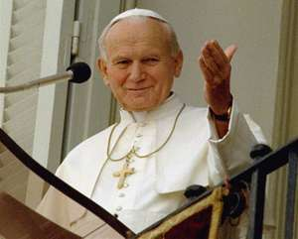
POPE JOHN PAUL II
Pope John Paul II made history in 1978 by becoming the first non-Italian pope in more than 400 years. He was a vocal advocate for human rights and used his influence to effect political change. A charismatic figure, John Paul used his influence to bring about political change and is credited with the fall of communism in his native Poland. On July 5, 2013 the Vatican announced that the Roman Catholic Church would declare Pope John Paul II a saint. The announcement of Pope John Paul II's canonization came after the Vatican revealed that two miracles were attributed to the late pope.

Slide 4
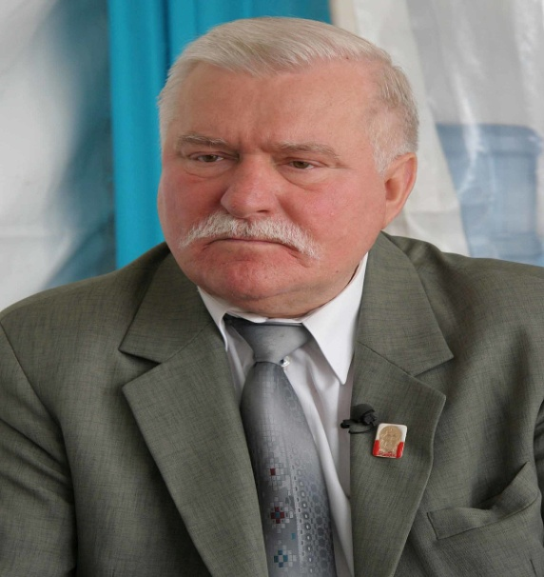
Lech Walesa
Lech Walesa, well-known Polish labor leader and winner of the Nobel Peace Prize, is sworn in as the first noncommunist president of Poland since the end of World War II. His victory was another sign of the Soviet Union’s lessening power and communism’s waning influence in Eastern Europe. Martial law was imposed in 1981 and shortly thereafter Walesa was arrested and put into solitary confinement. Upon his release from prison, Walesa resumed his union efforts. The Solidarity movement rapidly gained in strength and popularity.

Slide 5
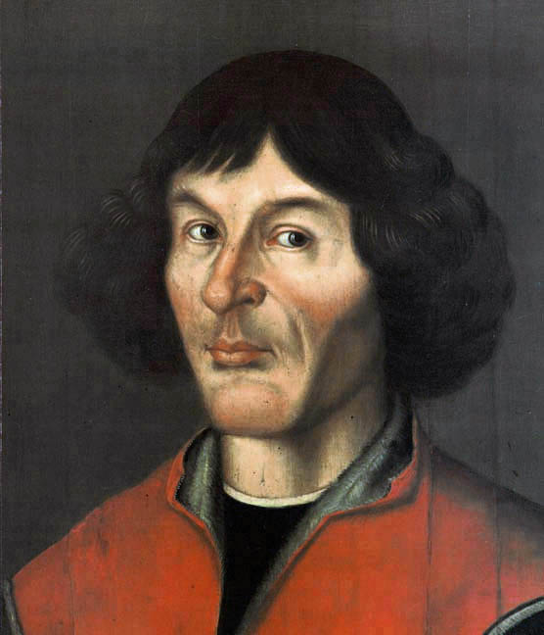
Nicolaus Copernicus
In the 16th century, when virtually everyone believed Earth was the center of the universe, Polish scientist Nicolaus Copernicus proposed that the planets instead revolved around the sun.

Slide 6
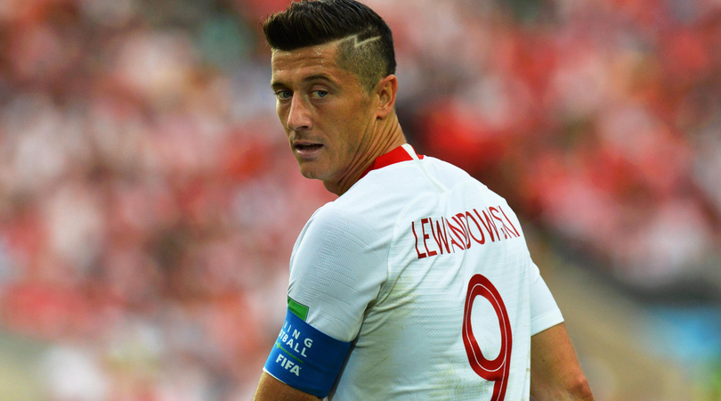
Robert Lewandowski is a Polish professional footballer who plays as a striker for Bayern Munich and is the captain of the Poland national team.

Slide 7
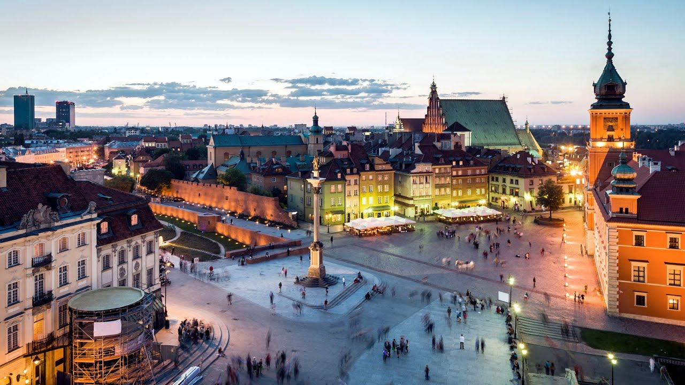
Warsaw
Warsaw is the capital of Poland. The metropolis stands on the Vistula River in east-central Poland. Warsaw, the 8th most-populous capital city in the European Union, is a major international tourist destination, and a significant cultural, political and economic hub. Its historical Old Town was designated a UNESCO World Heritage Site.

Slide 8
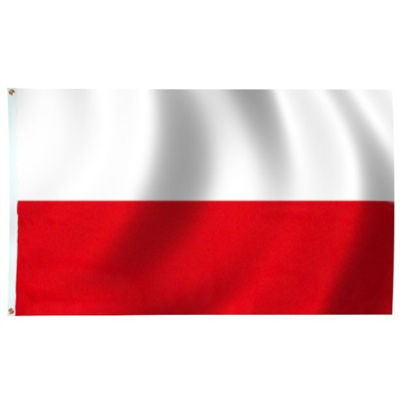
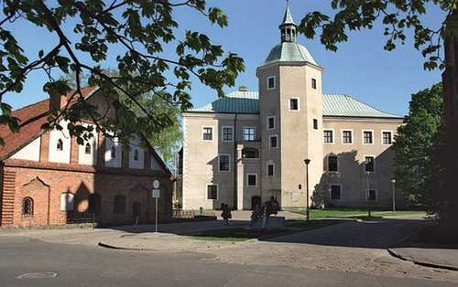
Poland, officially the Republic of Poland, is a country located in Central Europe. It is divided into 16 administrative subdivisions. Poland is bordered by the Baltic Sea and has a climate characterized by cold winters and warm summers.
Slupsk
It is a pleasurable experience to explore the remnants of its tumultuous past: Gothic and Secession tenement houses, the Renaissance-Gothic town hall, the 14th century town gates, the Old Town with its bourgeois abodes and interesting monuments - or the best-known of all of Slupsk’s landmarks, the 16th-century Castle of the Pomeranian Dukes on the Slupia River, now housing Museum of Mid-Pomerania.

Slide 9
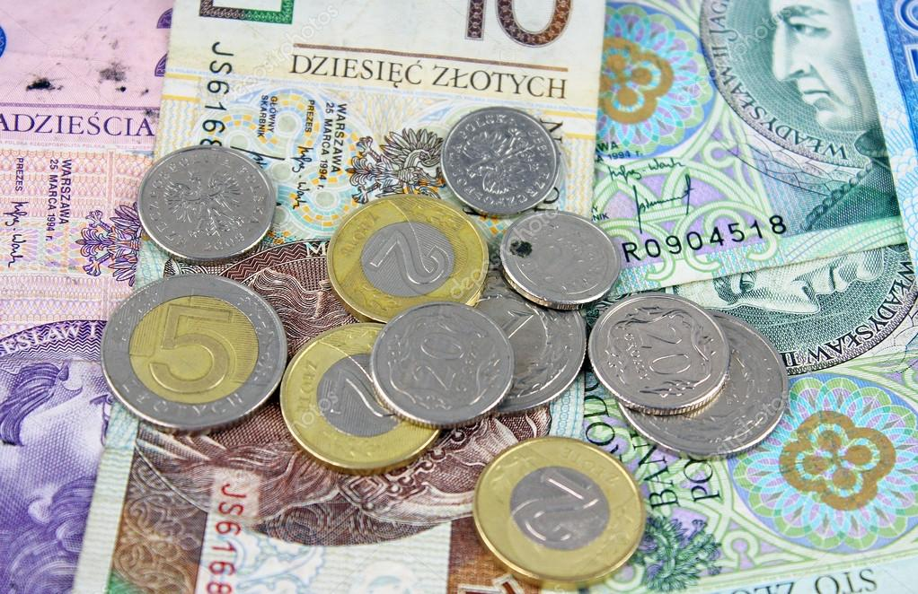
Polish złoty
Polish złoty is the official money of Poland. Each zloty is divided into 100 groszy. As a result of inflation in the early 1990s, the currency underwent redenomination. The zloty was first adopted during the reign of Sigismund.

Slide 10
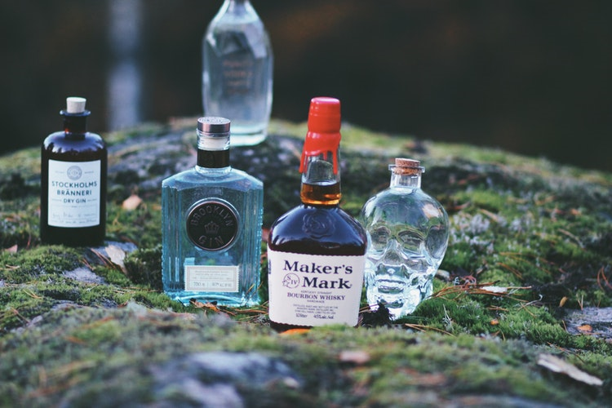
Poland is famous for Vodka!
Polish Vodka is on the list of Protected Geographical Indications.
Pablo Picasso loved Polish Vodka
Before the war, Polish Vodka was served in mikadkas.
A museum of Polish Vodka is being created in Warsaw.

